Slide 1
Introduction to Data Analysis

Slide 2
Contents
Characteristics of Data
Challenges in handling large data
Good Data versus Bad data
Types of Data Analysis
Steps in Data Analysis

Slide 3
Characteristics of Data
The characteristics of Data are
Data at Rest
Data in Motion
Structured Data
Unstructured Data
Semi-structured Data

Slide 4
Stages of Data
The three stages of Data are
Data at Rest
Data in Motion
Data in Use
Structured Data
Unstructured Data
Semi-structured Data

Slide 5
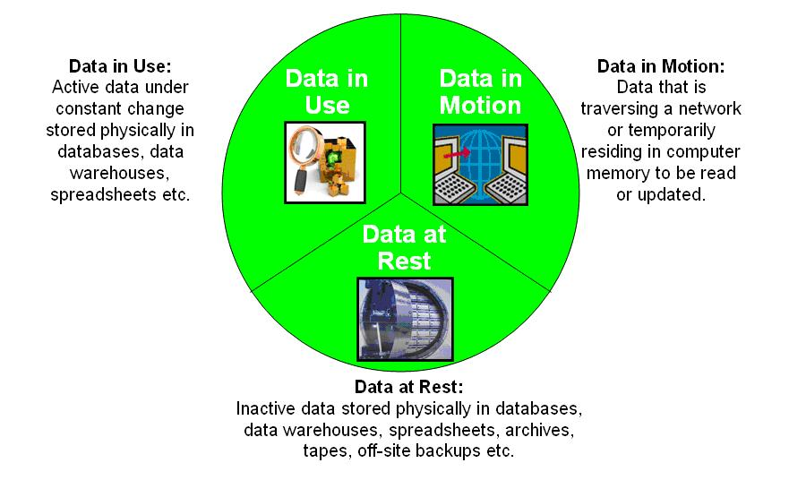
Stages of Data

Slide 6
Data at Rest
The data at rest means inactive data that is stored physically in any digital form.
Example: Spread-sheet, archives, Database, Data warehouses, disks, tapes, local network storages, mobile devices
[Wikipedia]

Slide 7
Data in motion
Data that is traversing a network or temporarily residing in a computer memory to be read or updated.
Two categories
Information that flows over the public or untrusted network.
Ex: data on Internet
Information that flows with in a private network.
Ex: LAN (Local Area Network) within an enterprise
Ex: The data that traverses from one mobile to another either in the form of SMS, WhatsApp messages, Bluetooth etc.

Slide 8
Data in use
Data in use refers to active data that is residing non-persistent digital state typical in Random Access Memory, CPU Caches, CPU registers
We can even refer to Data in Cloud as Data in Use. The Cloud Software-as-a-service providers refer to this as “data in use” as this data is currently being processed by applications
Data in Use is increasing its concern to business as the volume of data is going up drastically
Also has sensitive information

Slide 9
Structured Data
Arrangement of data in hierarchal way with strong coordination between data in the organization of data is known as Structured Data
This data contains information of data types, data restrictions, data storage and data accessing methods
Structured Query Language is often used to manage Structured Data
Structured Data can be easily analyzed from the data types and other data information
Structured Data can be fetched from any accessible search engine.

Slide 10
unstructured Data
The arrangement of data in a complex way which may contain different data types, different data source and other data information known to be Unstructured Data
Data Science deals with transformation of unstructured data into structured data
E-mail is an example of Unstructured Data, since it lags hierarchy. Data is arranged with date and time and not with subject and content
Prediction of future values is not possible with Unstructured Data. The transition from structured to unstructured data leads to semi structured data

Slide 11
Semi-structured Data
Semi Structured Data is data between Structured and Unstructured data
Semi Structured is majorly recognized to be structured data without any proper data labels
Example of semi structured data are internet of things, majority of the dataset used in data analysis, social media, videos, notes from call center and human computer interaction
The importance of Semi structured data lies in extracting right information from internal source and external source

Slide 12
Challenges in handling large data
Classification in this domain is tricky and complex
Analysis of Data utilizing both supervised method and unsupervised method for high dimensional information is troublesome
The high dimensional data are noisy
Noise inside the information will be all the more high information proportionality
Curse of dimensionality
Different phenomena that emerge while breaking down and sorting out information in high dimensional space refers to Curse of dimensionality

Slide 13
Challenges in handling large data
Spurious connection
High dimensionality gets spurious connection as numerous uncorrelated irregular factors can have high sample connection coefficient in high-measurements. Spurious connection thus prompts wrong inferences.
Sparse Learning in High Dimensions
As the accessible information turns high, the volume of the space increases and the accessible information gets Sparse

Slide 14
Good Data versus Bad data
Data which can be entered in Excel table directly is known as Good Data
Data other than Good Data are known to be Bad data. Qualities of Bad Data for data in table are listed below
Column without headings
Blank headings
Fake headings
Merged cells
Multiple meaning in a column
Different data types
Empty rows or columns

Slide 15
Steps in Data Analysis
The steps in Data Analysis are discussed in following five steps
Step 1: Begin with right question
Inquiries ought to be quantifiable, clear and brief
Inquiries planned should either qualify or preclude potential answers for your particular issue or opportunity
For instance, begin with a plainly characterized issue: An administration contractual worker is encountering increasing expenses and is no more drawn out ready to submit aggressive contract recommendations.
One of numerous inquiries to tackle this business issue may include: Can the organization diminish its staff without bargaining quality?

Slide 16
Steps in Data Analysis
Step 2: Set Clear Measurement Priorities
What to measure?
Measurement for the most part alludes to the allocating of numbers to show diverse estimations of factors
Measurement of height of a employer is easy, but how to measure intelligence of employee? Based on IQ of the employer or with project he has done. Hence what to measure should be decided clearly
How to measure?
Key things to ask for this progression include:
What is your time allotment? (e.g., yearly versus quarterly expenses)
What is your unit of measure? (e.g., USD versus Euro)
What components ought to be incorporated?(e.g., Salary plus other benefits)

Slide 17
Steps in Data Analysis
Step 3: Collect Data
Gather information about source of the data
Is Data from data set or other means of sources
Collecting limitation of the data/ error survey
Step 4: Analyse Data
As you manipulate Data, you may discover you have the correct information you require, however more probable, you may need to modify your unique question or gather more data
In any case, this underlying examination of patterns, relationships, varieties and outliers helps you center your information investigation on better noting your question and any complaints others may have

Slide 18
Steps in Data Analysis
Step 5: Interpret Results
As you interpret the aftereffects of your data, pose these key inquiries:
Does the information answer your unique question? How?
Does the information help you protect against any protests? How?
Are there any constraint on your decisions, any edges you haven't considered?

